Slide 1
EC3290 – Software Requirements Engineering
Topic 3 – Requirements Analysis, Modeling, and Specification

Slide 2
Learning Objectives
Understand the difference between description and specification.
Learn various modeling techniques and diagrammatic notations.
Explore Use Case Modeling and Scenario Descriptions.
Gain insights into domain analysis and requirements understanding.
Introduce formal specification techniques.

Slide 3
Introduction to Requirements Analysis
Process of determining user expectations for a new or modified system.
Prevents requirement misunderstandings.
Ensures better system design.
Reduces project failure risk.

Slide 4
Description vs. Specification
Description:
Natural language explanation of system behavior.
Often informal and ambiguous.
Specification:
Precise and structured representation of system behavior.
Uses models, diagrams, and formal notations.
Example:
Description: "The system should allow users to login."
Specification: "The system shall authenticate users using a valid username and password stored in the database."

Slide 5
Requirements Modelling Techniques
Purpose of Modelling:
Visual representation of complex system requirements.
Enhances understanding and communication.
Key Techniques:
Use Case Modelling
Data Flow Diagrams (DFD)
Entity-Relationship Diagrams (ERD)
Class Diagrams (UML)

Slide 6
Use Case Modelling and Scenario Descriptions
Use Case Diagram:
Captures interactions between users and the system.
Identifies system functionality.
Scenario Descriptions:
Details different paths in system operation (Normal, Alternative, Exception flows).

Slide 7
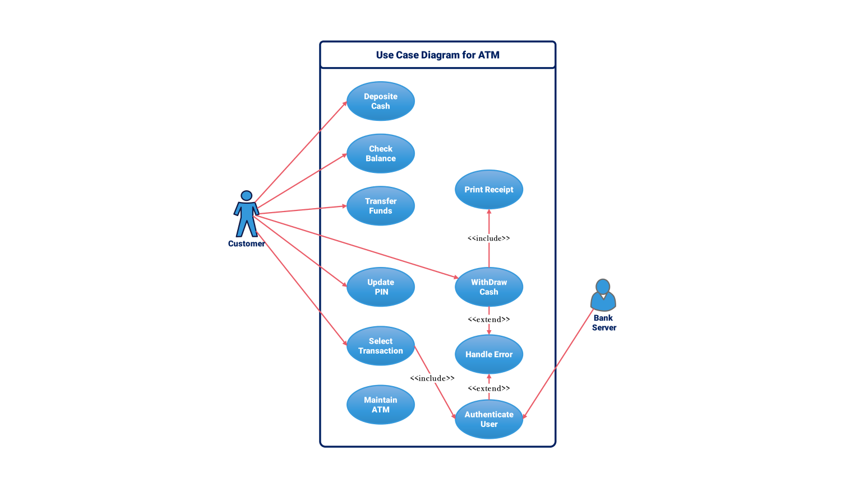

Slide 8
Data Flow Diagrams (DFD)
Represents how data moves through a system.
Components:
Processes (Circle)
Data Stores (Rectangle)
External Entities (Square)
Data Flows (Arrows)

Slide 9
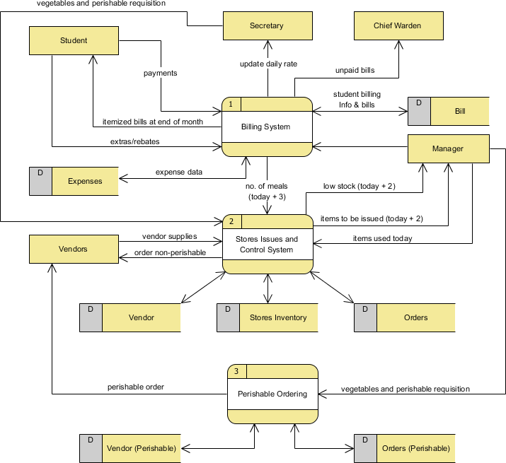

Slide 10
Entity-Relationship Diagram (ERD)
Definition: Diagram that models database structure.
Key Elements:
Entities (Objects like Students, Courses)
Attributes (Properties like Student Name, Course Code)
Relationships (Associations like Enrolled-In)

Slide 11
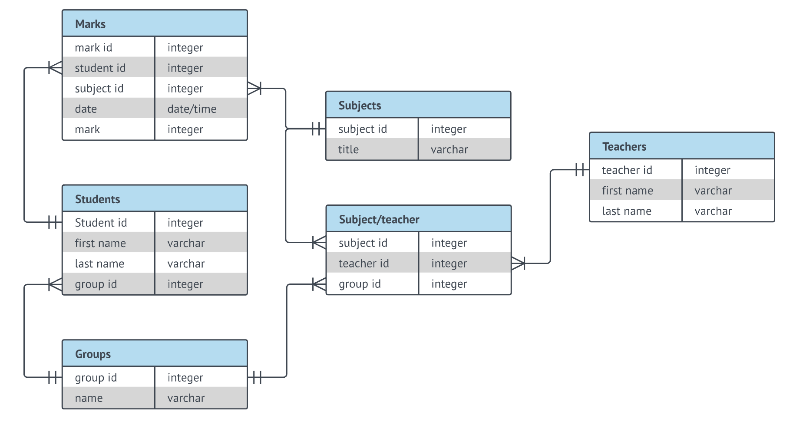

Slide 12
Analysis for Understanding the Domain and Requirements
Domain Analysis:
Identifying system environment, stakeholders, and constraints.
Techniques: Interviews, Questionnaires, Document Analysis.
Requirement Analysis Approaches:
Structured Analysis (DFD, ERD)
Object-Oriented Analysis (UML Diagrams, Class Diagrams)

Slide 13
Use Case Description Format
Use Case Name: Login Process
Actors: User, Authentication System
Preconditions: User must have an account
Main Flow:
User enters username and password.
System verifies credentials.
User is granted access.
Alternative Flow: Wrong password → Show error message.

Slide 14
Formal Specification
Definition: Mathematically-based techniques to specify software requirements.
Why is it useful?
Removes ambiguity.
Improves verification and validation.
Common Methods:
Z-Notation, B-Method, VDM (Vienna Development Method)

Slide 15
Benefits of Using Formal Specification
Precise and unambiguous.
Reduces misinterpretation.
Helps with system validation before development.

Slide 16
Challenges in Requirements Analysis
Common Issues:
Unclear or vague requirements.
Changing requirements.
Conflicting stakeholder interests.
How to overcome them?
Regular communication with stakeholders.
Using prototypes and visual models.

Slide 17
Real-World Example – Software Requirement Failure
Case Study: London Ambulance System Failure
System designed without clear requirements.
Lack of proper analysis led to incorrect dispatching.
Lesson: Proper requirement engineering prevents system failures.

Slide 18
Industry Best Practices in Requirements Engineering
Define SMART Requirements:
Specific, Measurable, Achievable, Relevant, Time-bound.
Use Requirement Management Tools:
JIRA, IBM Rational DOORS, ReqSuite.

Slide 19
Summary
Requirement Analysis ensures clear, complete, and correct requirements.
Modeling Techniques help visualize requirements for better understanding.
Use Case Modeling captures user interactions.
Formal Specification provides a rigorous, mathematical approach to defining requirements.

Slide 20
End of Topic 3

